Slide 1



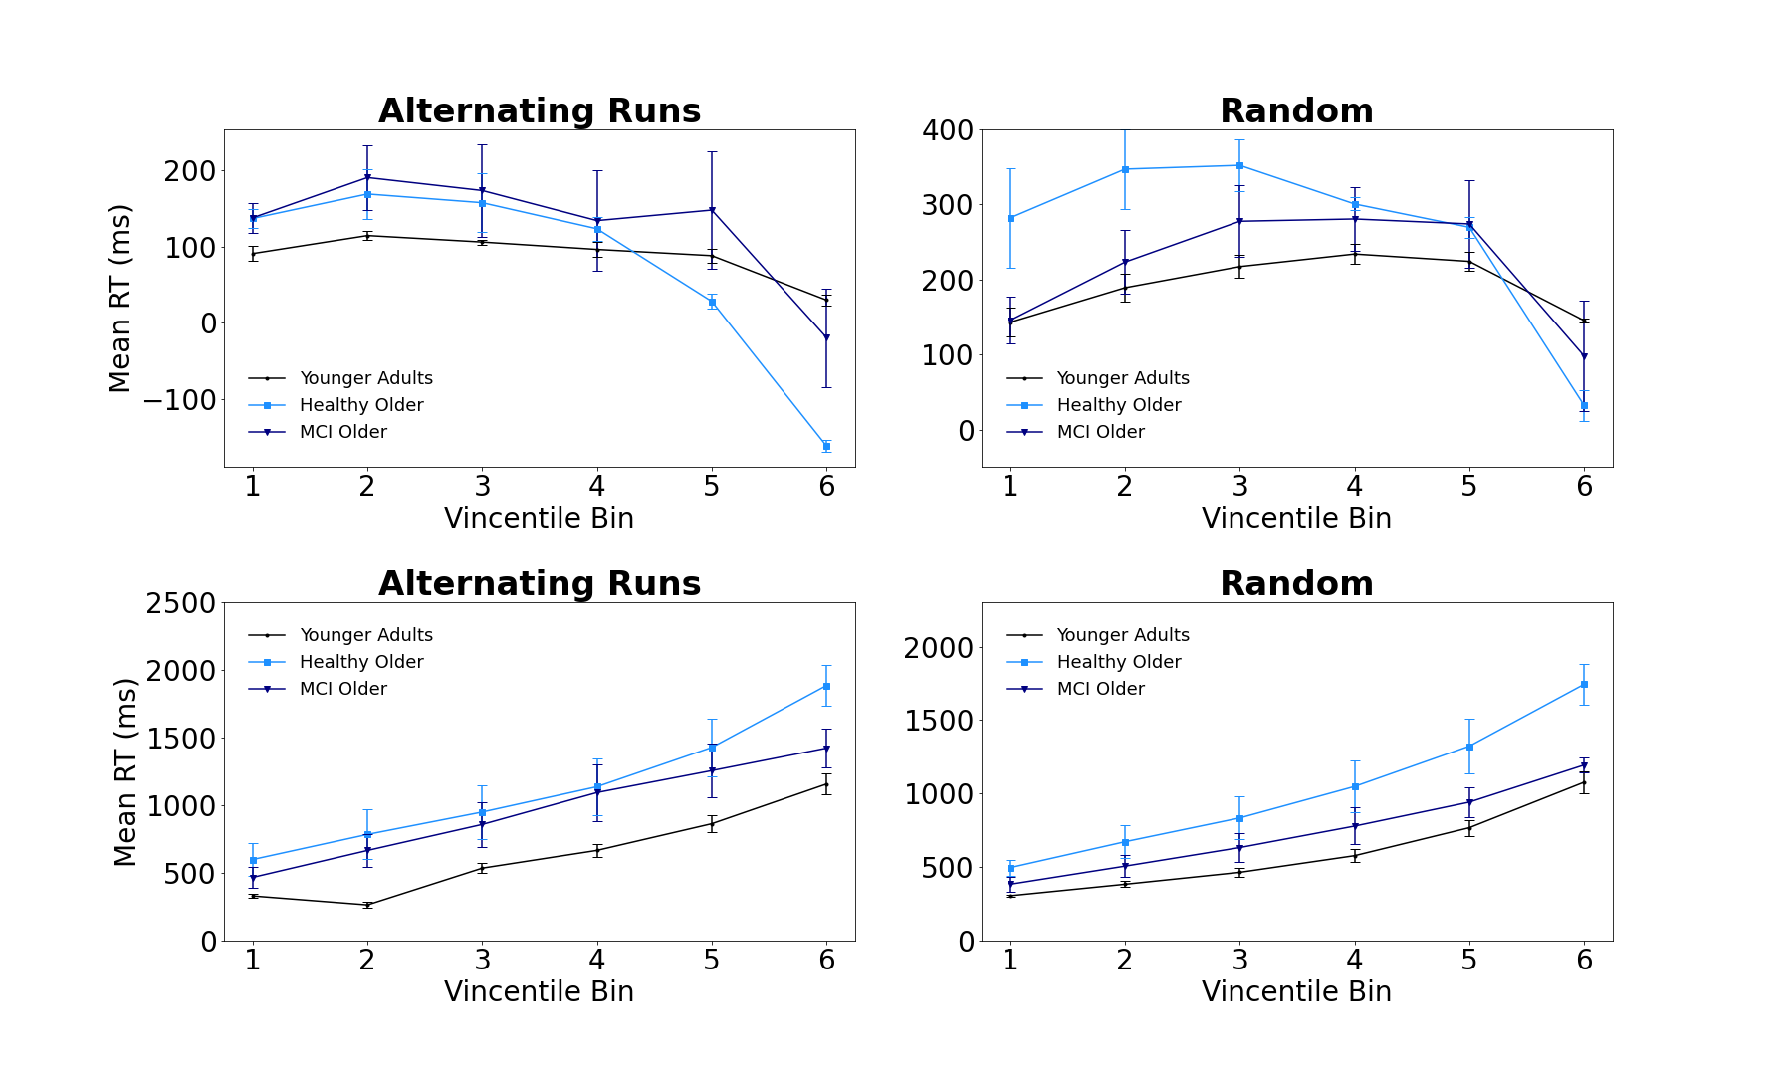
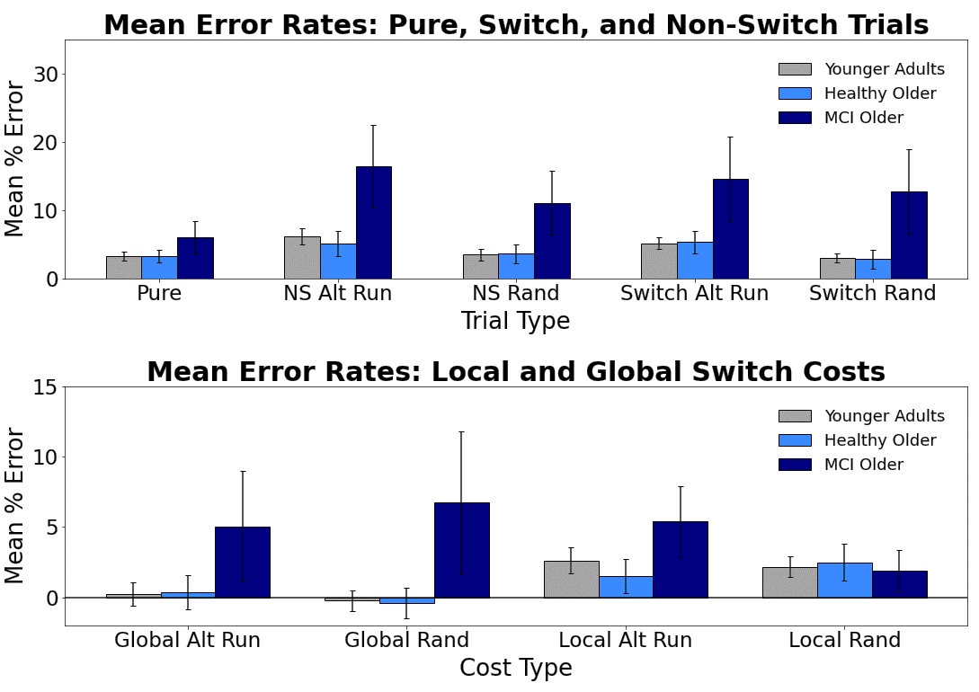
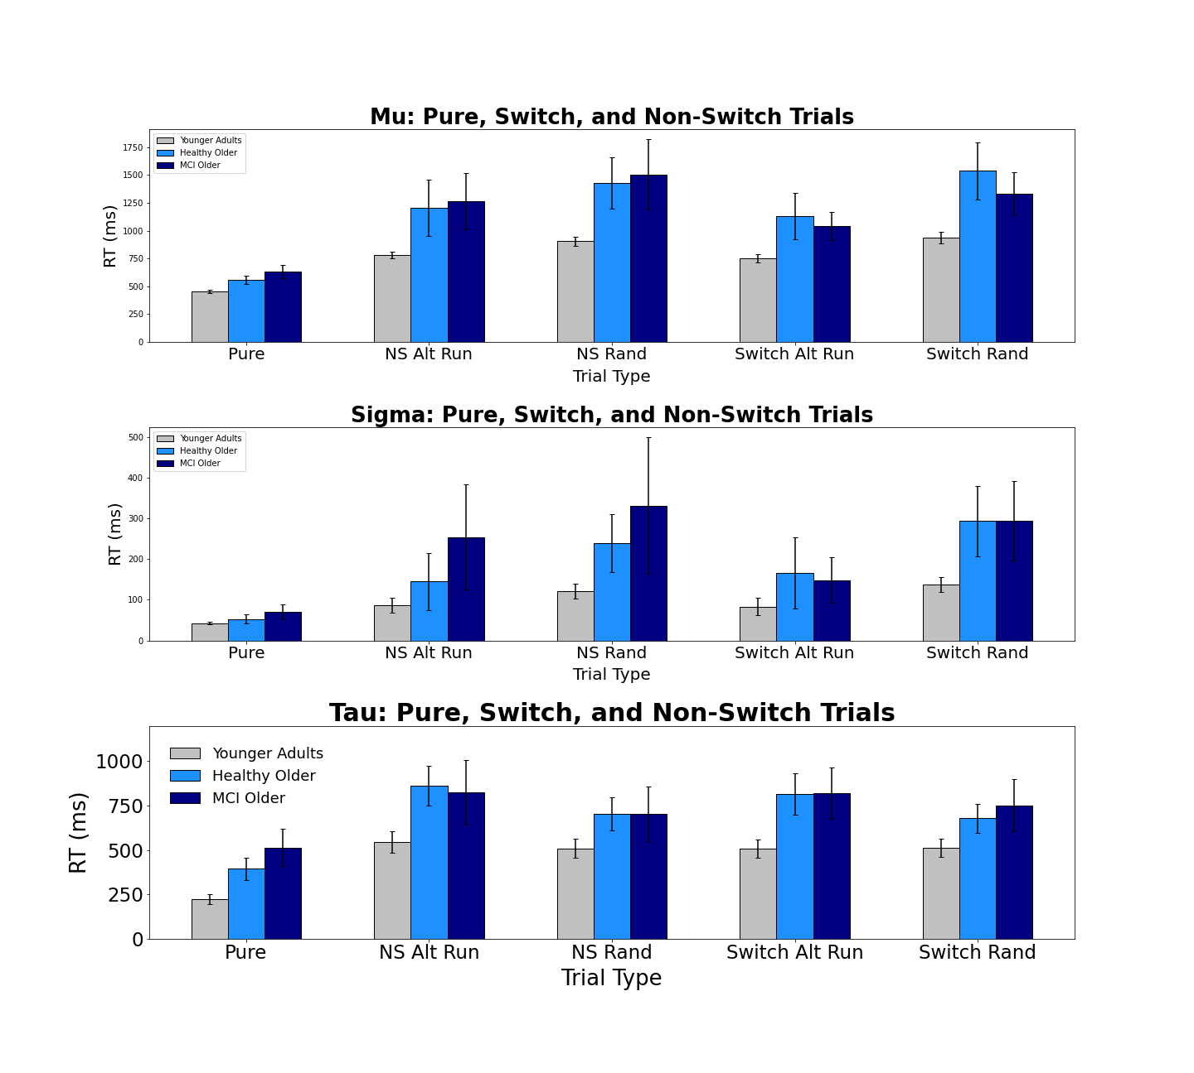
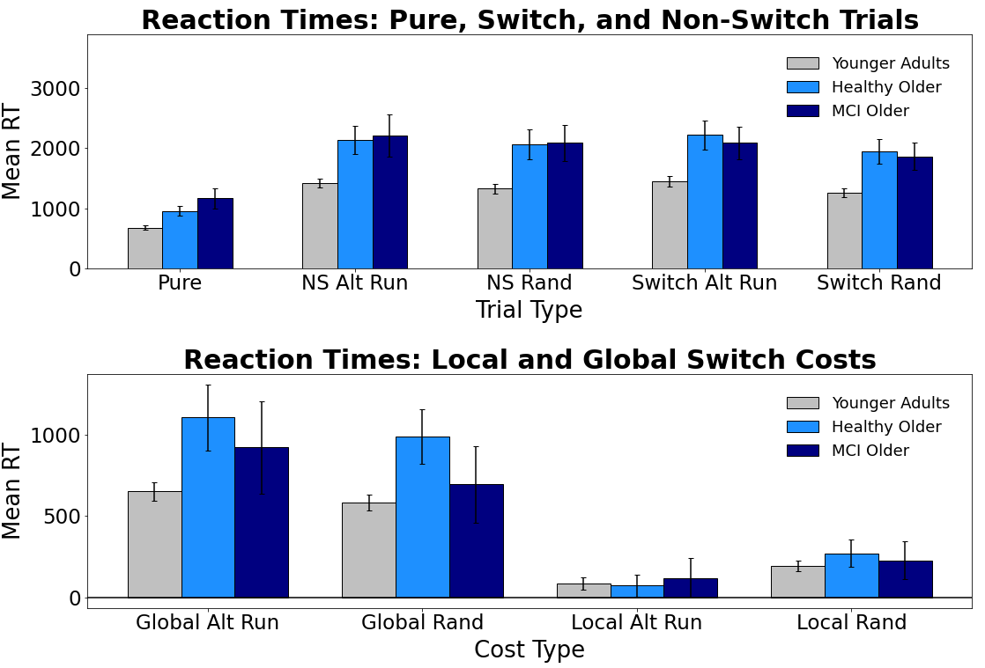
Evaluating Switch Costs using Alternating-Runs and Random Sequencing in the Consonant-Vowel/Odd-Even Task in Younger, Healthy Older, and Mildly Impaired Older Adults
Jacob M. Namias, Nicholas P. Maxwell, & Mark J. Huff
Introduction
General Method
Vincentile Plots
In the Consonant-Vowel/Odd-Even switch task (CVOE, Minear & Shah, 2008) participants view bivalent stimuli (e.g., A 08) quickly classify the letter (Consonant/Vowel) or the number (Odd/Even). Because participants complete pure blocks (e.g., all trials are the CV task) and switch blocks (e.g., participants switch between both classification tasks), the CVOE paradigm allows for comparisons between global and local switch costs. Global costs (i.e., non-switch trials - pure trials) represent the cost of keeping multiple task-sets active in working memory. Alternatively, local costs (i.e., switch trials - non-switch trials) reflect task-set reconfiguration processes that occur due to switching.
Previous research has shown global costs for both errors and response times (RTs) increase with age and for individuals with mild cognitive impairments (MCI; e.g., Alzheimer's Disease), while these conditions decrease local costs for RTs (Huff et al., 2015). Furthermore, Huff et al. showed that distributional analyses of RTs (e.g., Vincentile plots) reveal dissociations between local and global switch costs, such that global costs increase while local costs decrease.
Studies investigating CVOE task switching have often used presented trials via a predictable, alternating runs sequence (e.g., CV, CV, OE, OE, CV, CV). The present study expands upon this by comparing alternating runs switching with random switching. Unlike an alternating runs sequence, random switching has no discernable pattern. As a result, we expected participants would find the random switching task more difficult, and that these difficulties would be reflected in greater error rates and RTs compared to alternating runs switching. Furthermore, given breakdowns in working memory and attentional control processes that are associated with AD, we expected that MCI older adults would particularly struggle with the random switch task. Thus, we expected that differences in switch costs previously found using alternating runs would be particularly exaggerated for these individuals when switching was non-predictive.
Pure Blocks
Switch Blocks
MoCA
Local Switch Costs
Note: Participants completed four blocks (CV, OE, Alt Runs, and Random). The first two blocks always contained pure trials (CV or OE). The final two sets of trials were always switch blocks (Alt Runs or Random).
Global Switch Costs
Results: Mean Errors
Ex-Gaussian Analysis
Bars = 95% CI
Bars = 95% CI
Participants
Bars = 95% CI
Conclusions
Results: Mean RTs
Across trial types, MCI older adults produced more errors compared to younger and healthy older adults. Additionally, both older adult groups provided consistently slower responses. Regarding mean switch costs for errors, MCI individuals had greater global switch costs (regardless of presentation mode) compared to younger and healthy older adults. For local costs, MCI older adults again showed greater costs, but only when switching was predictive. For RT switch costs, older adults showed greater global costs compared to younger adults, though no differences in local costs were detected between groups.
Vincentile plots were then used to further assess changes in switch cost RTs. Starting with local costs, all groups showed decreased costs across bins. For alternating runs switching, healthy older adults showed decreases in costs relative to younger adults and MCI older adults. For global costs, all groups showed increases across bins. These increases were greater for alternating runs switching relative to random switching. Finally, an ex-Guassian analysis of RTs indicated that both older adult groups had greater mean Tau values relative to younger adults, indicating that.. [Expand]
Overall, our findings show that presentation mode does not affect mean errors, RTs, or their respective switch costs. Instead, differences occurred primarily as functions of age and health.
Group | n | M Age | % Female | M MoCA
Younger Adults | 89
Healthy Older | 33 | 73.92 | 75% | 27.75
MCI Older | 26 | 75.88 | 41% | 24.00
Materials
Letters: A, D, E, H, I, J, I, P, S, U
Numbers: 1-99
Pair
A 15
D 04
E 23
H 36
Task
CV
CV
OE
OE
Correct Response
P
Q
Q
P
Correspondence can be addressed to jacob.namias@usm.edu.
More info available at: www.macapsych.com | https://osf.io/yrdsz/
Bars = 95% CI

